Slide 1
Lesson 6
Space Environment

Slide 2

Notes:
An aurora is a natural, vibrant light display in the sky, appearing as curtains or spirals of color, caused by charged particles from the Sun (solar wind) colliding with gases (oxygen, nitrogen) in Earth's upper atmosphere, creating light similar to a neon sign.
How it works
Solar Particles: The Sun constantly sends energetic particles (solar wind) towards Earth.
Magnetic Field: Earth's magnetic field funnels these particles towards the poles.
Atmospheric Collision: Particles collide with gases (oxygen, nitrogen) in the upper atmosphere, exciting them.
Light Emission: As the excited atoms return to their normal state, they release photons (light), creating the colorful display.
AKA
A geomagnetic storm is a temporary but intense disturbance of Earth’s magnetosphere caused by enhanced energy input from the Sun. It occurs when solar plasma and embedded magnetic fields strongly couple with Earth’s magnetic field, driving large electrical currents and rapid magnetic-field variations. It is a space weather event that injects energy into near-Earth space far beyond nominal conditions.
What triggers a geomagnetic storm
Primary solar drivers
Coronal Mass Ejections (CMEs)
Massive clouds of magnetized plasma ejected from the Sun.
Most severe storms occur when the CME’s magnetic field is southward, enabling strong magnetic reconnection with Earth.
High-speed solar wind streams
Often originate from coronal holes.
Tend to cause moderate but long-duration storms.

Slide 3
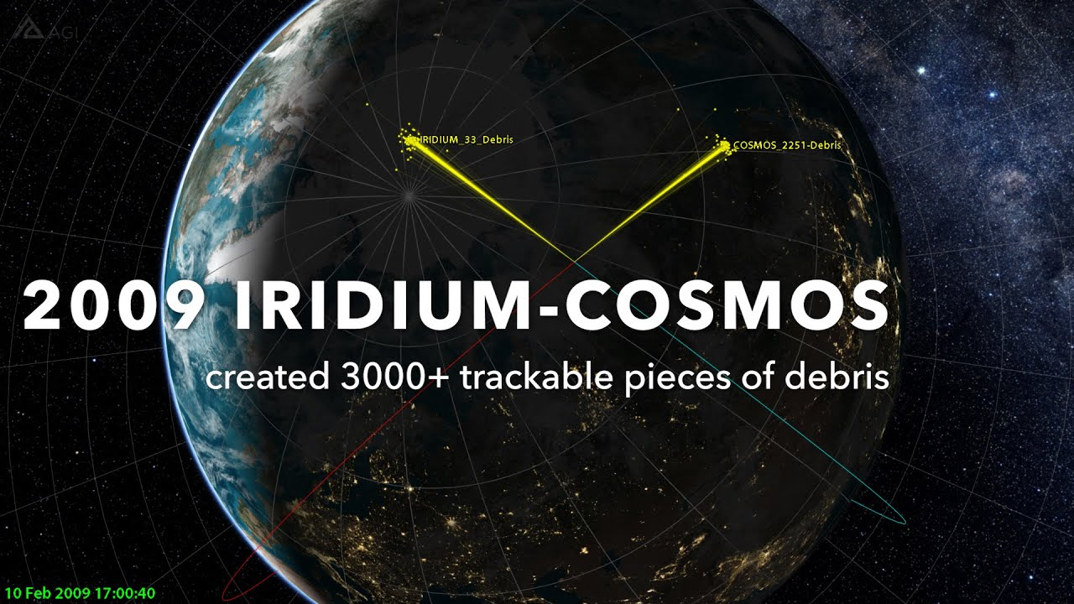
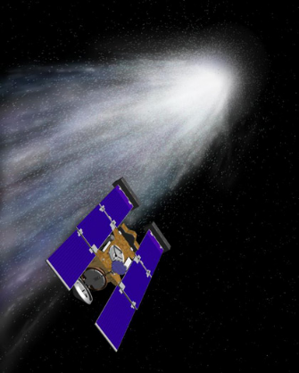
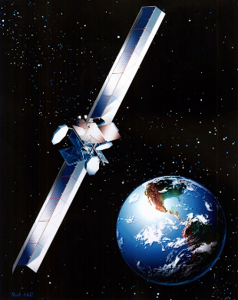
Why Worry about the Space Environment?
Approximately 25% of all spacecraft anomalies are related to the space environment.
Famous examples include:
2010: Control of Galaxy 15 lost due to electrostatic discharge cause by solar flare. Satellite drifted through crowed GEO belt in full send and receive mode
2009: Iridium satellite destroyed when it collided with the dead Cosmos 2251 satellite (space debris)
2000: Boeing 702 satellite (Anik F-1): degraded solar array performance due to outgassing induced fogging
2000: Stardust comet flyby spacecraft blinded and sent into safe mode by a solar flare
1994: Telsat Canada’s Anik E-1 and E-2 suddenly began to spin out of control due to spacecraft charging
1990: High energy charged particles caused bit flips in HST fine guidance system electronics (FGS) passing through the South Atlantic Anomaly (SAA) causing guide star acquisition failures. Subsequently, FGS use was suspended in the SAA.
1979: Increased solar activity heated the outer layers of the Earth's atmosphere and thereby increased drag on Skylab, leading to an early reentry.
Warning- Traffic Hazard!. Iridium Collision with Cosmos 2251
Caution - Solar Flare. Stardust spacecraft was blinded by a solar flare
Beware - Outgassing. Anik F-1 degraded performance due to outgassing
Notes:
On 10 February 2009, two satellites crossed paths over northern Siberia at an altitude of roughly 790 kilometers. There were no alarms, no last-second maneuvers, and no human decision point.
At 16:56 UTC, Iridium 33, an operational U.S. commercial communications satellite, and Kosmos 2251, a long-dead Russian military spacecraft, collided at a closing speed of nearly 11.7 km/s.
The impact was instantaneous and catastrophic.
Both spacecraft were shattered into thousands of fragments—each fragment now a high-velocity projectile capable of destroying other satellites. In less than a second, two objects became a debris field that would persist for decades.
No component failed. No software bug was triggered. No operator made a bad call.
The mission failed because the orbital environment itself had become unsafe.
Iridium 33 was actively tracked and controlled. Kosmos 2251 was not. It had been drifting, uncontrolled, for years—still massive, still fast, still lethal. At the time, collision-avoidance models did not treat inactive satellites as high-risk targets. The probability of a satellite-satellite collision was considered vanishingly small.
That assumption was wrong.
The collision instantly increased the cataloged debris population by more than 2,000 trackable objects, with tens of thousands more too small to monitor. Many of those fragments crossed the orbits of other operational spacecraft, forcing evasive maneuvers and increasing long-term collision risk across Low Earth Orbit.
From the ground, the event was a single blip on radar screens. From an orbital-mechanics perspective, it was a phase change—the moment when LEO crossed from “crowded” into collision-dominated risk.
Why this matters
The Iridium–Kosmos collision demonstrated that space environment hazards are no longer purely natural. The environment is now shaped by human legacy hardware, poor end-of-life planning, and exponential risk growth.
For spacecraft designers, this event reframed key assumptions:
A satellite does not need to be active to be dangerous
Collision risk is no longer negligible
Debris generation is irreversible on operational timescales
Individual missions can degrade the environment for all future missions
In space systems engineering, this collision marks the point where orbital debris became a first-order design constraint, not a background statistic.
The lesson is blunt: In orbit, nothing ever truly goes away—and eventually, everything you leave behind comes back at orbital velocity.

Slide 4
Terms
Survivability
Ability of space system to perform its mission after being exposed to a stressing environment or hostile action
Hardening
Design choice when building a space system to mitigate the negative impacts of the space environment or potential hostile action (eg: shielding, filtering, etc)

Slide 5
Space Environmental Influences
Microgravity
Vacuum
Atmosphere
Plasma
Radiation
Micrometeroids & Orbital Debris

Slide 6
Microgravity

Slide 7
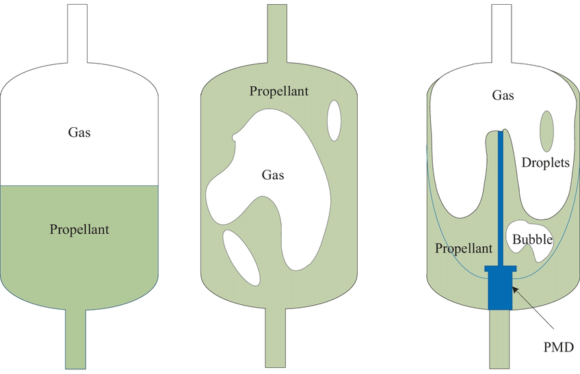
Microgravity
Source
Spacecraft is in free fall, where it is continuously falling through space where the forward velocity of the spacecraft is enough to match the velocity that would pull the spacecraft back toward the Earth’s surface
Effects on spacecraft
Fluid containment is a challenge
All articles must be secured
Allows uniform mixing of solutions
Allows opportunity for new manufacturing techniques
Strategies to mitigate effects
Pressurize liquids/gases in containers
Secure all components
Notes:
In microgravity, the central problem for a propellant tank is phase management: without gravity, liquid and ullage gas do not “separate” cleanly, so an engine feed line can ingest gas, causing cavitation, loss of thrust, and hard-start risk. The solution set falls into two broad categories: (1) force the liquid to where you want it, or (2) use tank internal hardware that passively “collects” liquid.
1) Settling methods (apply acceleration so the liquid behaves “as if” under gravity)
Thrust-settling (ullage burns)
Use small thrusters to provide a steady acceleration (often milli-g to a few percent of g), pushing liquid toward the outlet.
Common before main-engine start or during coast phases.
Design considerations:
Required acceleration depends on tank geometry, propellant properties, and disturbance environment.
Must avoid exciting sloshing modes that can destabilize attitude control.
Spin-settling
Impart angular rate so centrifugal acceleration drives liquid outward to the tank walls, creating a stable liquid region and ullage region.
Works well for some mission profiles, but complicates guidance/control and can be incompatible with payload pointing constraints.
“Slosh-aware” settling
Use baffles and operational constraints (thrust ramp rates, burn timing) to manage slosh during settling and engine start.
Often paired with thrust-settling to reduce propellant motion and gas ingestion risk.
2) Passive Propellant Management Devices (PMDs) (use capillarity/surface tension)
These rely on the fact that in micro-g, surface tension dominates (Bond number is small), so carefully designed internal structures can “wick” and retain liquid at the outlet.
Capillary acquisition devices (CADs)
Purpose: ensure liquid-only delivery to the feed line across expected micro-g disturbances.
Common CAD architectures:
Vane PMDs: radial/axial vanes guide liquid toward a sump/outlet via capillary action.
Screen-channel PMDs: a channel covered by a fine mesh/screen that allows liquid through but blocks gas up to a “bubble point” pressure.
Sponges / porous media: porous blocks near the outlet retain liquid and resist gas ingestion.
Troughs and gutters: shaped surfaces that preferentially hold liquid and direct it to the outlet.
Key design concept: capillary pressure margin
Surface tension creates a pressure difference across a curved interface: roughly
$$Δp∼\frac{2σ}{R}$$
where $σ$is surface tension and $R$is an effective radius of curvature.
Your PMD must generate enough capillary pressure to overcome:
dynamic pressure losses,
disturbances/accelerations,
pressurization transients,
and any required flow rate.
Liquid retention and “no-vapor” delivery
PMDs often include sumps and standpipes so the outlet stays in a controlled liquid zone.
For higher flow rates, designs may combine screen channels + vanes to both collect and deliver liquid.
3) Positive-expulsion tanks (separate propellant from pressurant physically)
These are widely used for storable propellants and small spacecraft because they make prop delivery largely independent of gravity.
Bladder tanks
Flexible bladder separates propellant from pressurant gas.
Pros: simple, excellent gas-free expulsion, good for small tanks.
Cons: material compatibility, permeation, life/aging, and bladder “wrinkling”/trapping residuals.
Diaphragm tanks
Elastomeric or metallic diaphragm moves as propellant is expelled.
Pros: robust separation, often better longevity than some bladders.
Cons: stroke limits; residual propellant can remain; diaphragm dynamics can matter at high flow.
Piston tanks
Sliding piston separates propellant and pressurant.
Pros: true positive expulsion, scalable, good for precision metering.
Cons: seals/friction, contamination, complexity, thermal/mechanical tolerance stack-up.
4) Operational and system-level techniques (supporting methods)
Pressurization strategy
Pressure-fed systems benefit strongly from positive expulsion or PMDs to ensure gas-free feed.
Pressurant management (He, N₂, autogenous) must avoid gas ingestion at the outlet and manage ullage volume evolution.
Thermal control (especially cryogenic)
Cryogens introduce additional challenges:
boil-off and venting change ullage behavior,
thermal stratification and geysering can occur,
PMD performance can vary with temperature and surface conditions.
Cryo stages often use a combination of settling + PMDs, and sometimes active methods (heaters, mixers, thermodynamic vent systems).
Propellant gauging in micro-g
Not a “keeping-liquid-at-the-outlet” method, but critical for operations.
Common approaches: PVT (pressure-volume-temperature) estimates, capacitance gauges, ultrasonic, radio-frequency/microwave, and bookkeeping.
How to choose (rules of thumb)
Small spacecraft / storable propellants / high reliability needs: positive expulsion (bladder/diaphragm/piston) is often the cleanest.
Larger tanks / higher flow / constrained mass: PMDs (especially screen-channel) + occasional thrust-settling.
Upper stages with long coasts: operational settling plus PMDs is common; pure settling without PMDs is riskier as coast times grow.
Cryogenic propellants: usually needs a combined architecture (thermal + settling + PMD), because boiling/venting complicates everything.
If you tell me (1) propellant type (storable vs LOX/LCH4/LH2), (2) expected flow rate / engine type, (3) tank size/geometry, and (4) coast duration and disturbance environment, I can recommend a specific architecture (e.g., screen-channel sizing approach, bubble-point margin targets, or whether a diaphragm tank is practical).

Slide 8
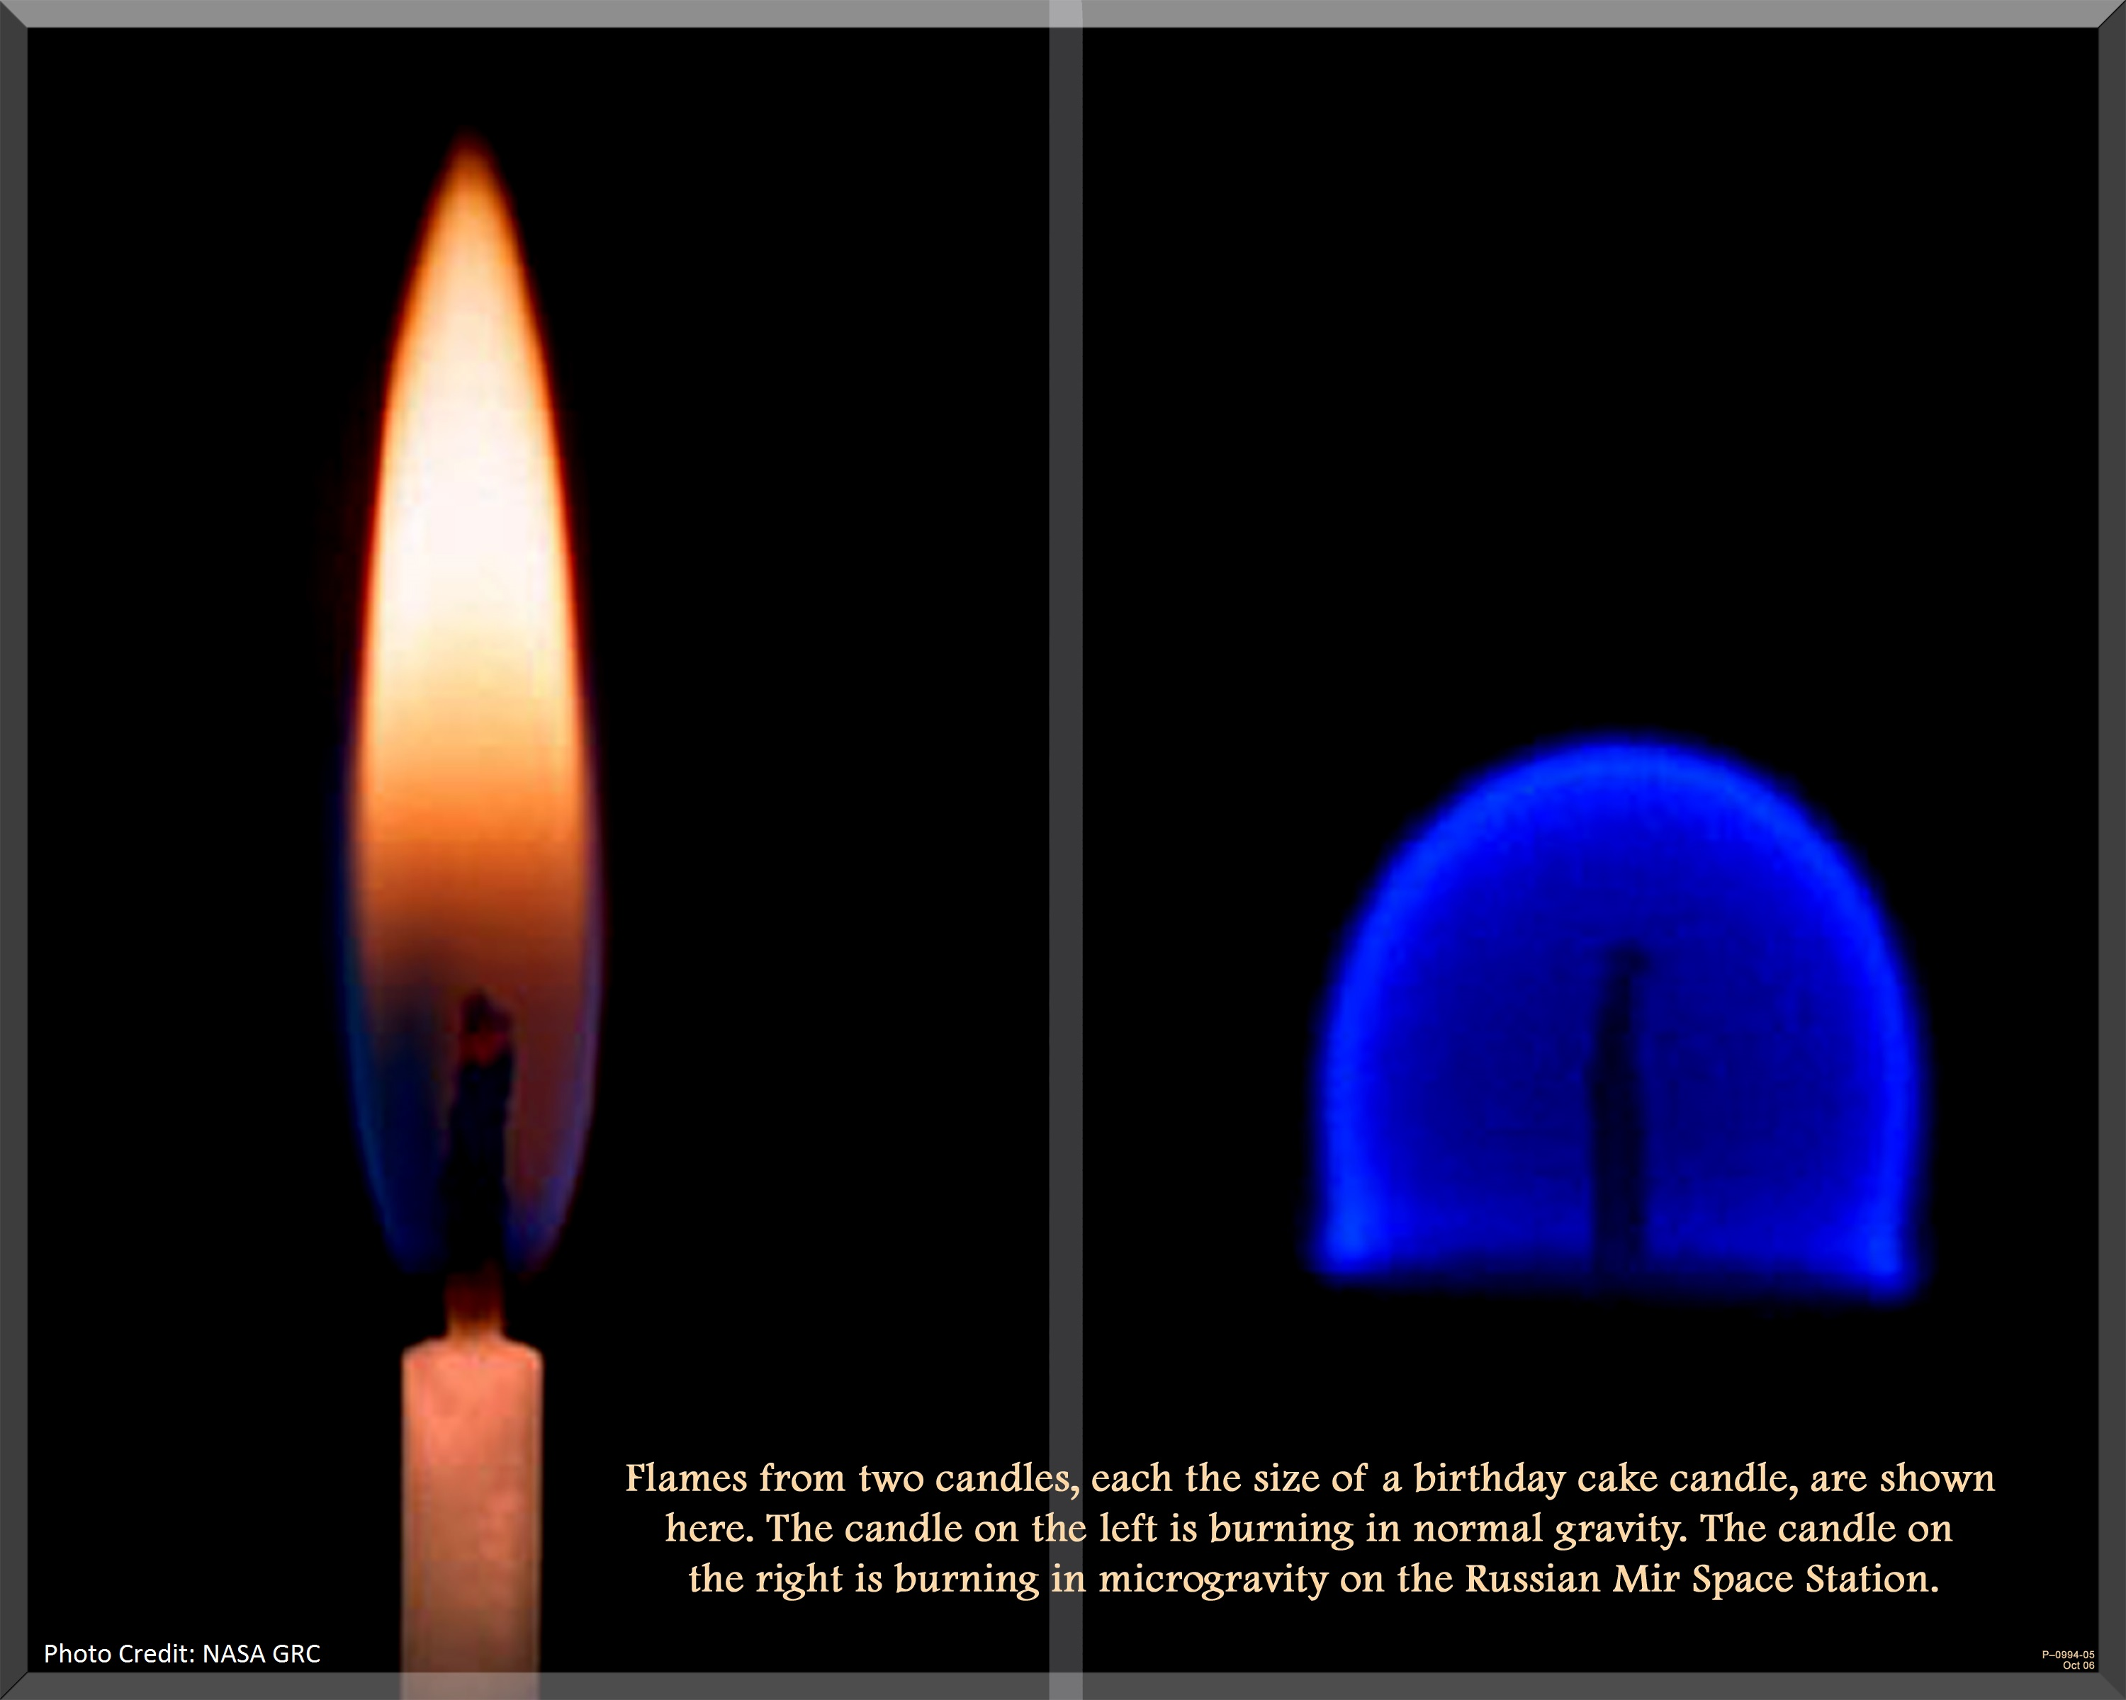
Notes:
Slide just for fun, flame in microgravity

Slide 9
Vacuum

Slide 10
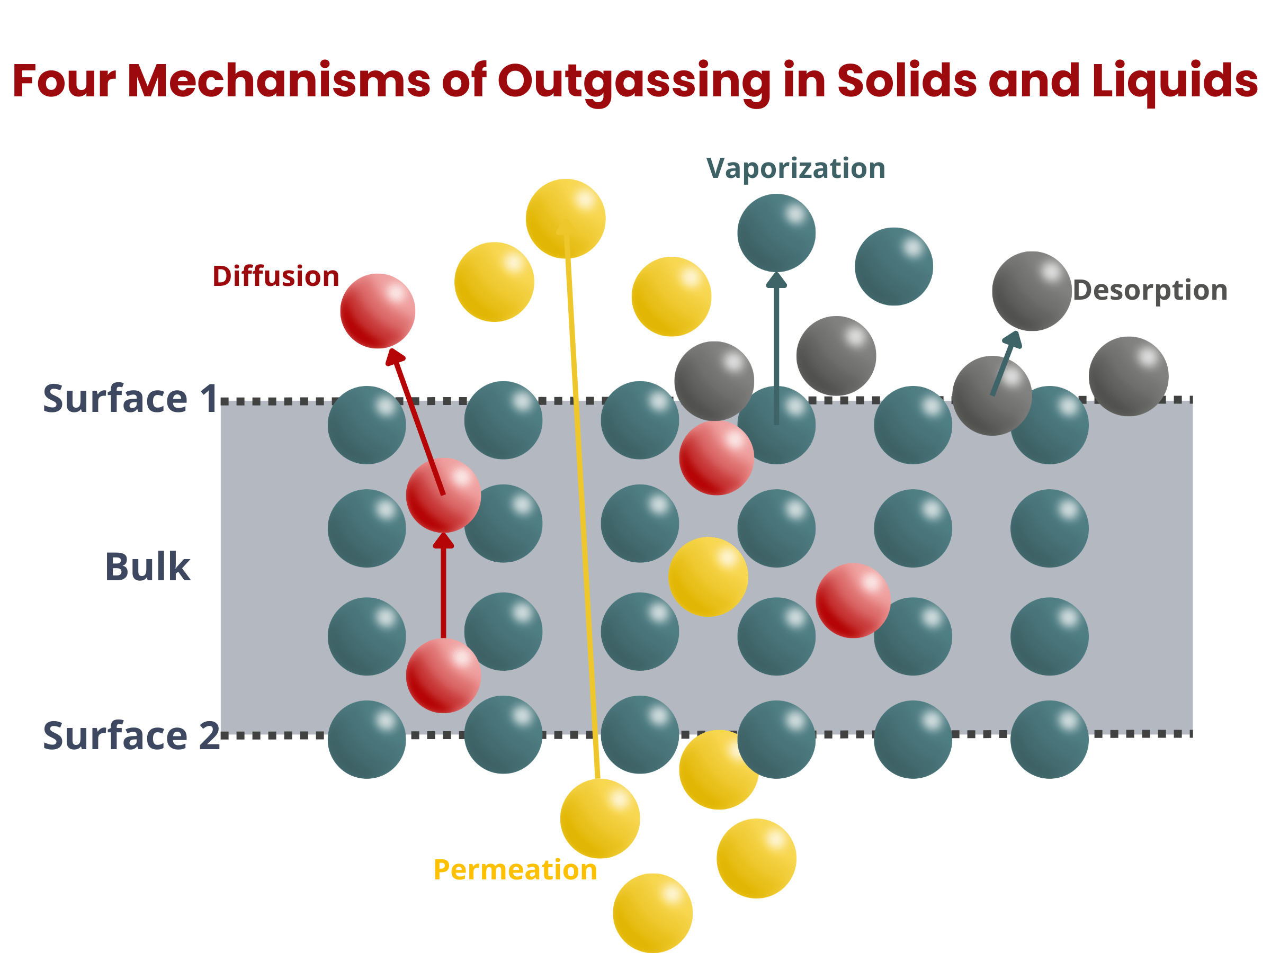
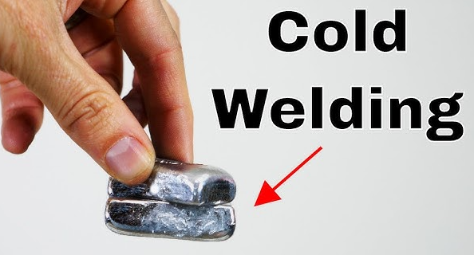
Vacuum
Source:
No air in space
Effects on spacecraft:
Outgassing: spurious release of molecules that contaminate surfaces
Cold welding: unintended material bonding when the atmosphere between surfaces is absent
Strategies to mitigate effects:
Use coatings that protect against UV radiation and do not outgas
Vent propellant/gas away from sensitive surfaces
Don’t put metal objects that are vulnerable to cold welding near each other
Vacuum bake-out on ground

Slide 11
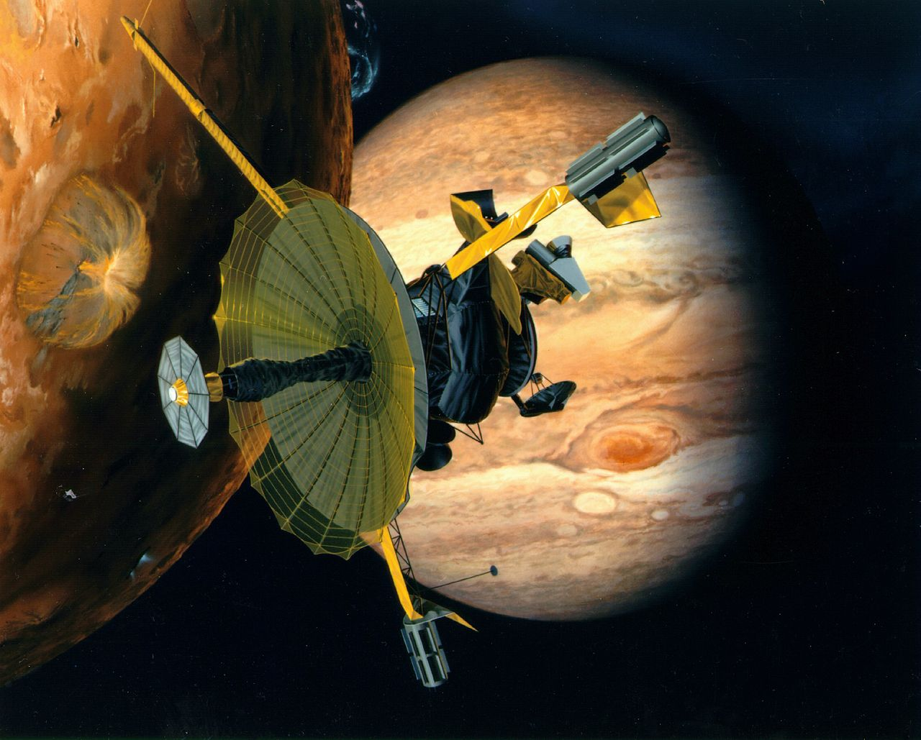
Notes:
The setup
In the late Cold War era, NASA launched Galileo, an ambitious spacecraft intended to orbit Jupiter and revolutionize planetary science. Central to the mission was a large high-gain antenna (HGA)—a ribbed, umbrella-like structure designed to unfurl in space and transmit high-rate scientific data back to Earth.
On Earth, the antenna had been tested repeatedly. It deployed reliably in air and thermal-vacuum chambers. Nothing appeared anomalous.
Then Galileo reached space.
The failure
When commanded to deploy, the antenna did not open.
Multiple retries failed. Engineers could tell the motors were turning, but the ribs remained stuck. The spacecraft was now hundreds of millions of kilometers from Earth, with no possibility of repair.
The root cause analysis converged on a subtle but devastating phenomenon:
cold welding (often coupled with galling).
What actually happened
The antenna’s deployment mechanism relied on metal-to-metal sliding contact between precision components—aluminum and titanium alloys chosen for strength and mass efficiency.
In the vacuum of space:
There is no oxide regrowth, moisture, or air film to separate metal surfaces.
Protective boundary layers that exist on Earth disappear.
Under load, microscopic asperities on opposing metal surfaces shear and fuse at the atomic level.
During Galileo’s long cruise phase:
Minor vibrations, thermal cycling, and preload forces caused progressive adhesion between contacting parts.
What began as increased friction evolved into localized cold welding.
By the time deployment was attempted, the ribs were effectively bonded together.
The motors were not strong enough to break the welded interfaces.
Why this was missed in testing
This is the most instructive part of the story.
Ground tests were time-compressed
The antenna was not left dormant for years under true vacuum and preload.
Thermal-vacuum testing was insufficiently representative
Test durations were short.
Micro-motion and long-term surface evolution were not reproduced.
Material pairing risk was underestimated
The design assumed that “clean machining + vacuum grease residue” was sufficient.
It was not.
The failure was not due to negligence—it was due to underestimating how hostile vacuum truly is.
Consequences
The high-gain antenna was lost permanently.
Galileo had to rely on a low-gain antenna, transmitting data at ~1/1000th the planned rate.
Mission scientists rewrote compression algorithms, operational timelines, and observation strategies.
The mission was partially salvaged—but at enormous cost and reduced scientific return.
Why this story matters today
Cold welding is not a historical curiosity. It remains a real, active failure mode:
Solar array hinges
Release mechanisms
Docking systems
Reaction wheel bearings
Deployment pins and latches
Modern spacecraft design now treats cold welding as a design-level hazard, not a materials footnote.
Lessons learned (now standard practice)
Never rely on bare metal sliding contact in vacuum
Use dissimilar materials with proven tribological compatibility.
Assume long-duration vacuum exposure
Dormancy is not benign; it is often when damage accumulates.
Use coatings and solid lubricants
MoS₂, WS₂, DLC, anodization, gold plating—applied intentionally, not incidentally.
Design for positive separation forces
Springs, pyros, or stored energy sufficient to break worst-case adhesion.
Test like you fly
Long-duration vacuum dwell tests with preload and micro-motion.
The takeaway
Galileo did not fail because space is unpredictable.
It failed because vacuum removes the assumptions engineers subconsciously make on Earth.
Cold welding is the archetypal lesson:
In space, metal does not merely touch metal — it becomes metal.

Slide 12
Atmosphere

Slide 13
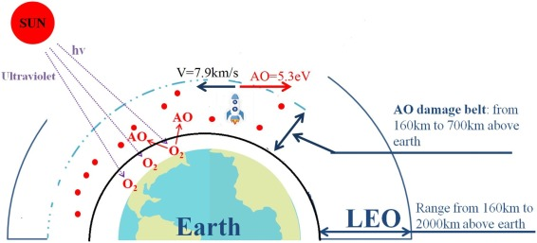
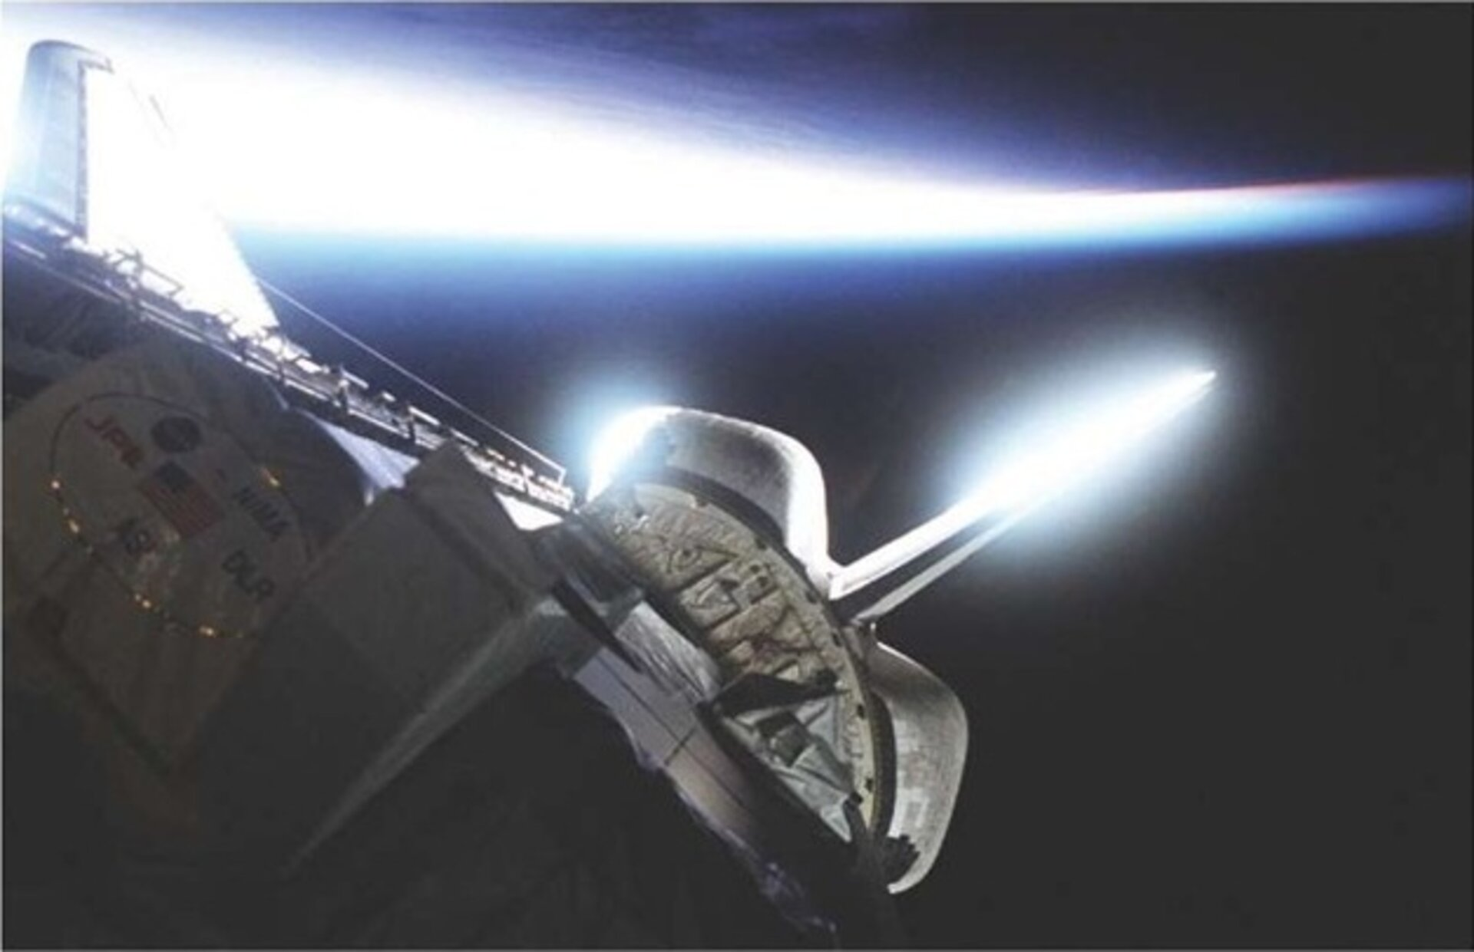
Atmosphere (1/3)
Source:
Particles in air around Earth
Effects on spacecraft:
Atomic oxygen: predominant atmospheric constituent from 200-600 km, forms when UV radiation dissociates molecular oxygen (Fig 8-5)
Atmospheric Drag
Strategies to mitigate effects:
Choose materials resistant to atomic oxygen or use protective coatings
Shield sensitive surfaces, design S/C with low coefficient of drag
Operate at higher altitudes if possible
Shuttle aglow with atomic oxygen
Notes:
Space Shuttle Endeavour's tail aglow with atomic oxygen, as seen during the STS-99 mission in February 2000. Highly erosive atomic oxygen turned out to eat away at unprotected thermal blankets during early Shuttle missions, until countermeasures were put in place.

Slide 14
Atmosphere (2/3)
Atomic Oxygen
Reacts with thin organic films, advanced composites and metallized surfaces
Degrades sensor performance
Weakens spacecraft structures
Density of atomic oxygen varies with the solar cycle
Solar cycle is periodic change in the amount of material and radiation emitted by the Sun and observed on Earth
Average of 11-year cycle; shortest was 9 yrs, longest 14 yrs
Solar maximum has many solar events; solar minima has almost no solar events
Solar flux varies substantially on a day-to-day basis and is difficult to predict at any given future time; however, average over an extended period is well known
Fig 8-1 depicts the F10.7 index, which is the mean daily flux at 10.7 cm wavelength in units of 10⁻²² W/m²·Hz
Notes:
Definition
Atomic oxygen (AO) is single, unbound oxygen atoms (O) rather than the familiar diatomic molecule O₂. On Earth’s surface, atomic oxygen is extremely rare because oxygen atoms rapidly recombine into O₂. In Low Earth Orbit (LEO), however, AO is abundant and highly reactive.
How atomic oxygen exists in space
In LEO (~200–700 km altitude), ultraviolet (UV) radiation from the Sun dissociates molecular oxygen:
$$O_{2}+hν→O+O$$
The atmosphere is thin enough that recombination is slow, allowing free oxygen atoms to persist.
Spacecraft traveling at ~7–8 km/s effectively slam into AO, increasing the relative kinetic energy of each atomic impact.
This makes AO one of the dominant environmental hazards in LEO.
Why atomic oxygen is dangerous
Atomic oxygen is chemically aggressive because:
It has an unpaired electron (highly reactive).
Impacts occur at orbital velocities, enhancing surface reactions.
Primary damage mechanisms
Oxidation of exposed materials.
Erosion of polymers through conversion to volatile oxides (CO, CO₂).
Surface roughening that degrades optical and thermal performance.
Commonly affected materials:
Kapton
Teflon (PTFE)
Polyimides
Paints, adhesives, cable insulation
Metals generally form thin oxide layers that self-passivate, but coatings and surface finishes still matter.
Real spacecraft effects
Solar array degradation (coverglass edge attack, polymer backing erosion).
Thermal blanket damage (MLI layer thinning).
Optical contamination and altered reflectivity/emissivity.
Structural thinning of exposed polymer components over long missions.
The International Space Station experiences continuous AO exposure, making AO mitigation a routine design consideration.
How engineers mitigate atomic oxygen
Material selection
Use AO-resistant materials (e.g., metals, ceramics).
Minimize exposed polymers where possible.
Protective coatings
SiO₂ (silicon dioxide) and other ceramic coatings act as AO barriers.
Aluminum oxide layers on metals provide passivation.
Coating integrity is critical—pinholes become attack sites.
Design strategies
Shield sensitive materials behind AO-resistant surfaces.
Orient spacecraft to minimize AO flux on vulnerable components.
Account for AO erosion rates in lifetime analyses.
Where atomic oxygen matters most
Low Earth Orbit missions (CubeSats, ISS, Earth-observing satellites).
Long-duration missions with exposed polymers.
Deployables (booms, blankets, solar arrays).
AO is not a concern in:
Geostationary orbit
Deep space
Lunar or interplanetary missions
Engineering takeaway
Atomic oxygen is a uniquely LEO problem that:
Does not exist in ground environments.
Can silently degrade spacecraft over time.
Must be addressed through materials, coatings, and system-level design.
It is a classic example of why space is not just “cold vacuum,” but a chemically active environment.

Slide 15
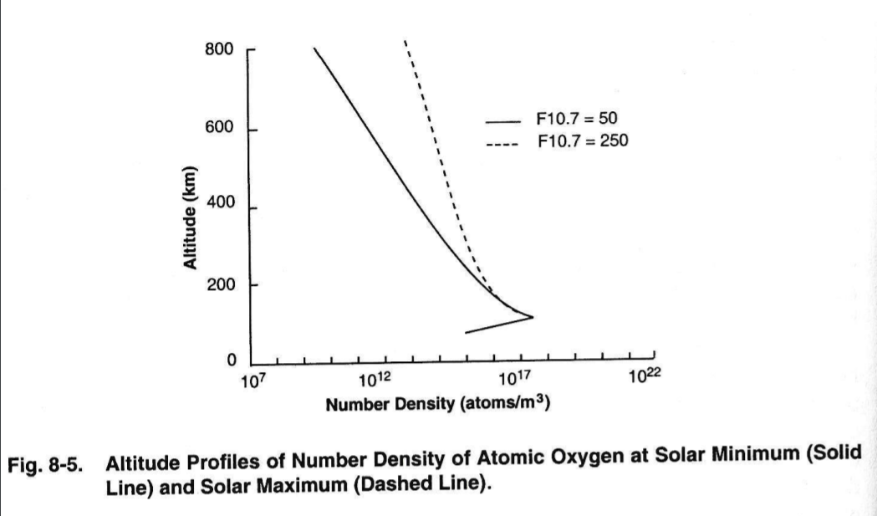
Atomic Oxygen

Slide 16
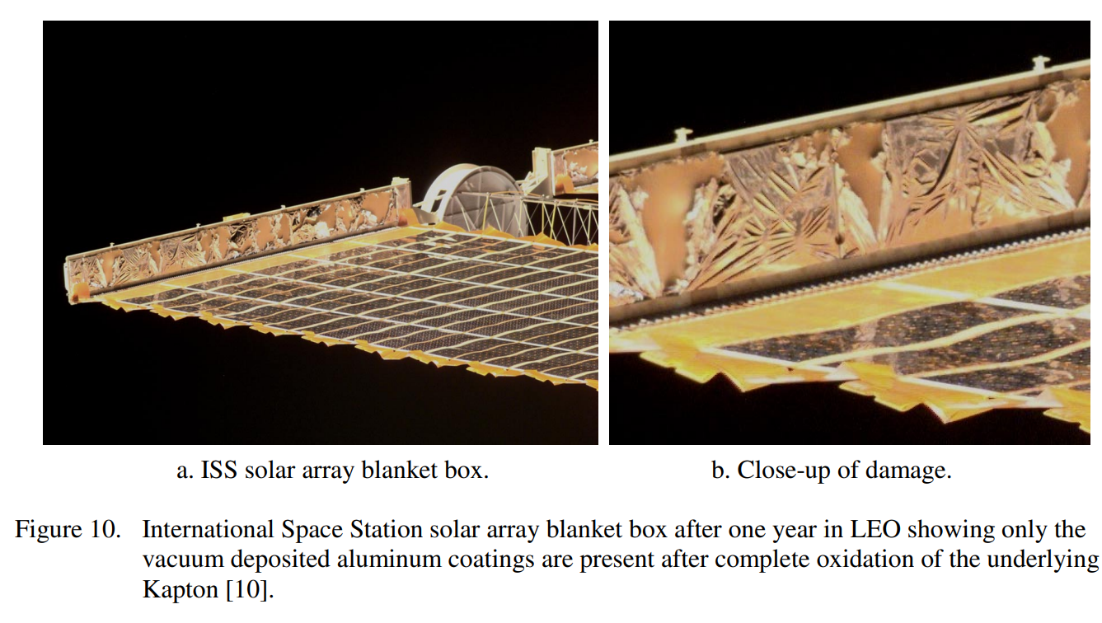
Atomic Oxygen - Example
Notes:
From https://ntrs.nasa.gov/api/citations/20040191331/downloads/20040191331.pdf

Slide 17
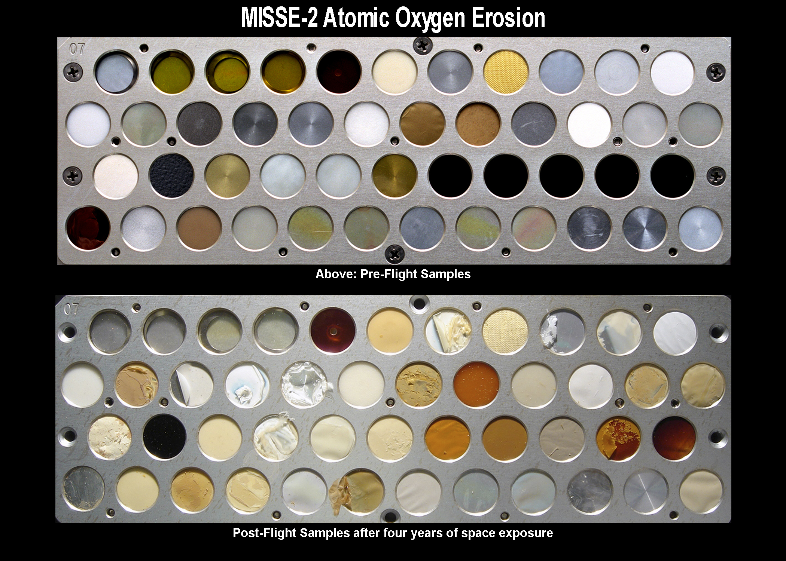
Atomic Oxygen – Example 2

Slide 18
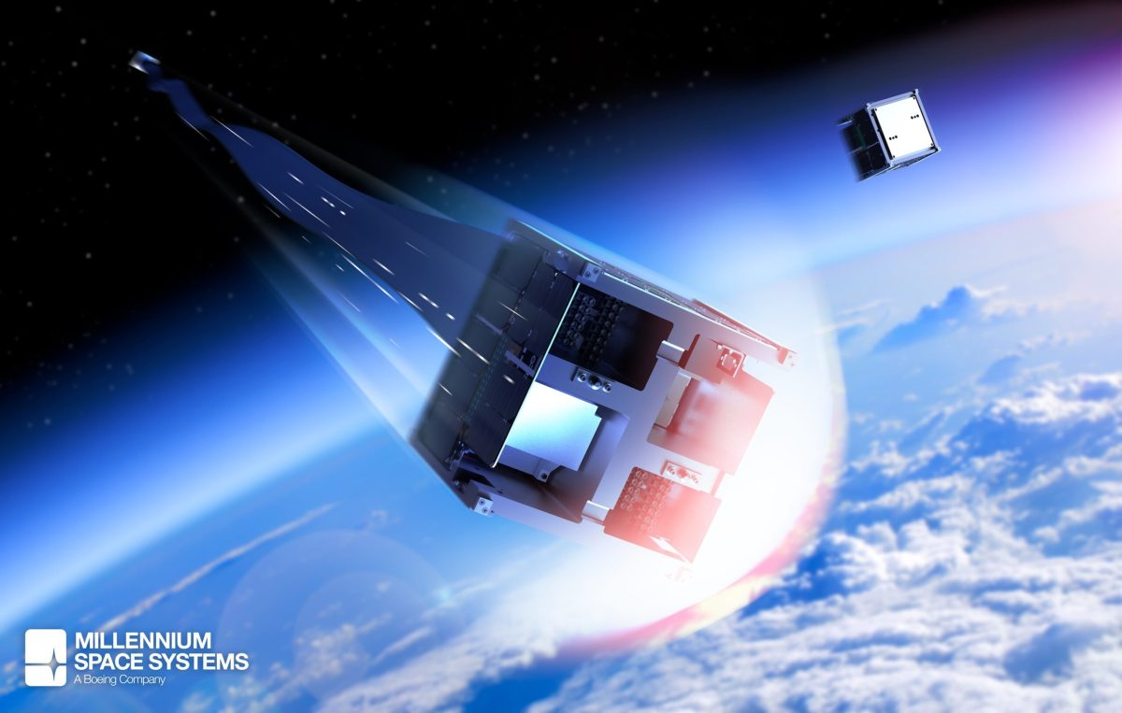
Atmosphere (3/3)
Atmospheric Drag
Depends on a variety of factors, including S/C ballistic co-efficient, speed and atmospheric density
Atmospheric density is highly dependent on solar cycle
Thermosphere: (120-600 km altitude), region where absorption of extreme UV radiation results in rapid increase in temperature with altitude
Heating due to EUV radiation and solar cycle variation impacts atmospheric density and has the greatest effect on satellite lifetimes

Slide 19
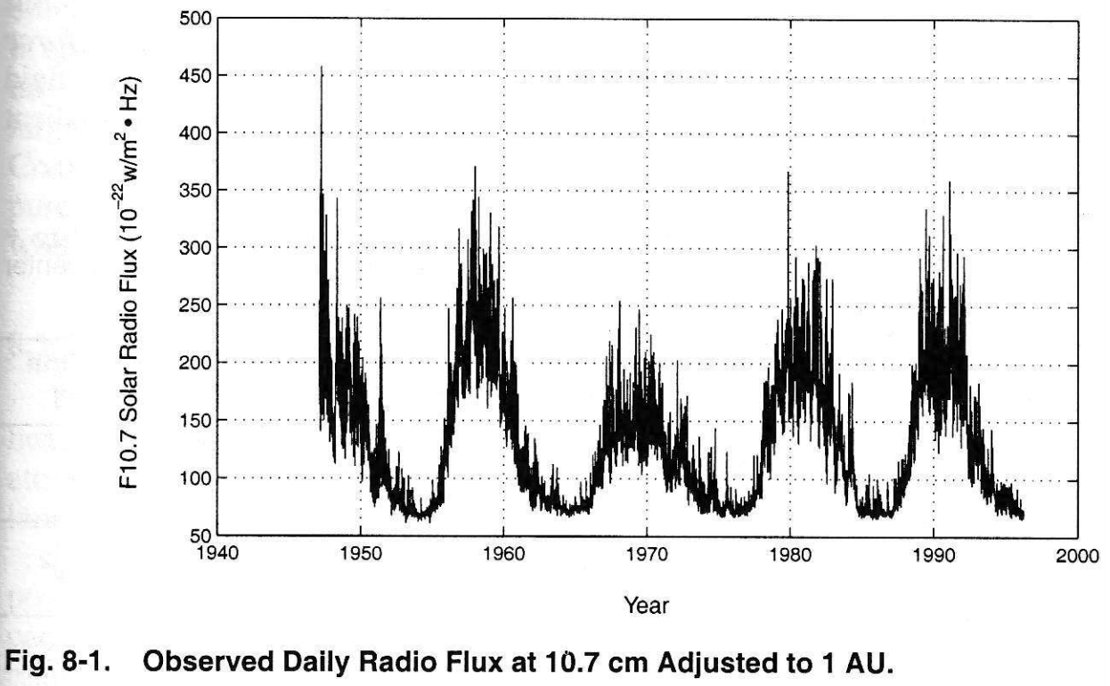
Solar Cycle

Slide 20
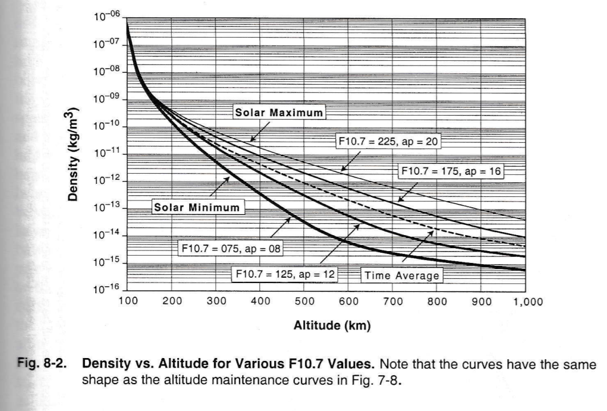
Impact of Solar Cycle on Atmospheric Density

Slide 21
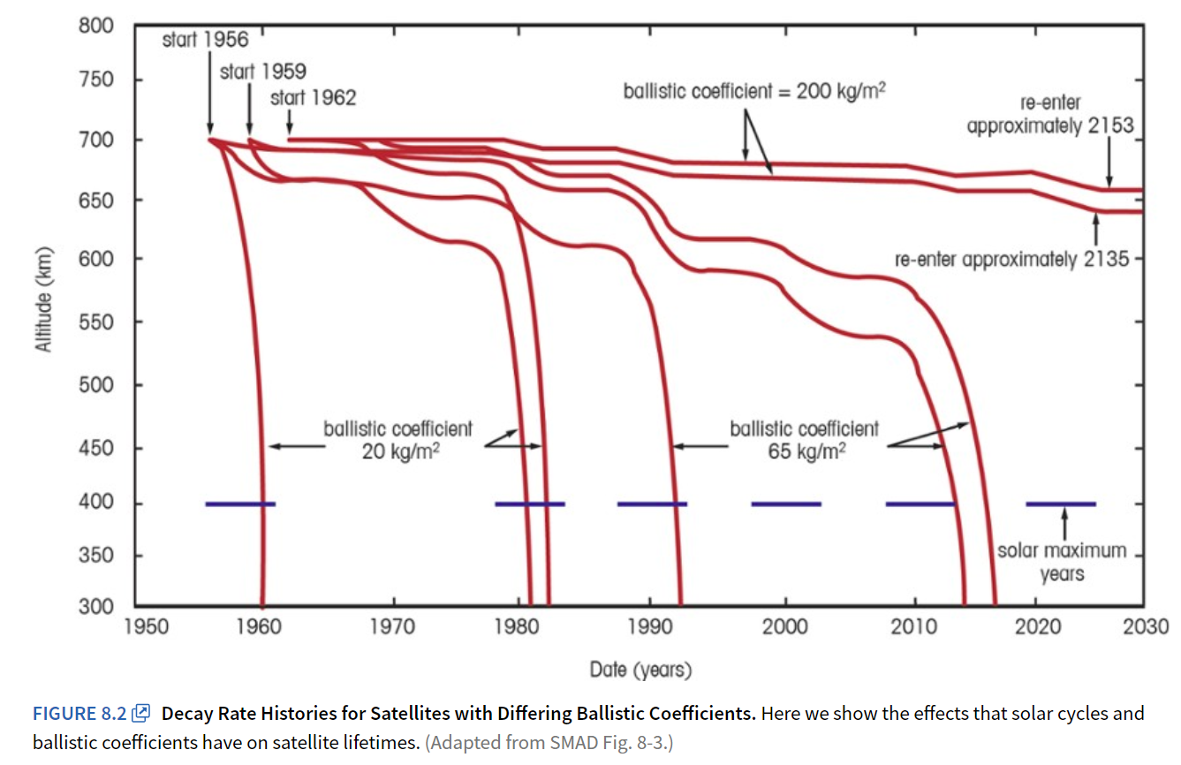
Impact of Solar Cycle/Ballistic Co-efficient on Satellite Lifetimes

Slide 22
Plasma
Notes:
Plasma
What it is: An ionized gas, where atoms are stripped of electrons, creating a superheated soup of ions and free electrons, like lightning or the sun's interior.
Key Properties: Conducts electricity, responds to electric/magnetic fields, and has unique emission spectra.
How it relates to radiation: Plasma generates radiation (e.g., bremsstrahlung, synchrotron) as its charged particles accelerate or change energy levels.

Slide 23
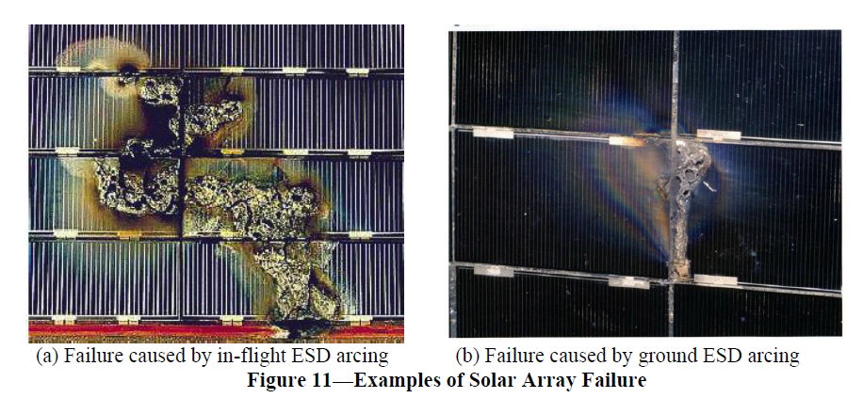
Plasma (1/2)
Plasma consists of neutral particles, positive ions, and electrons.
The most abundant matter in the universe (99% of universe mass)
Source:
Formed from interactions between solar wind and Earth’s magnetic field, stretches into long structure known as the magnetotail.
Can also come from solar flares or galactic cosmic rays (GCRs)
Notes:
https://www.emcunited.com/standards-info/nasa-hdbk-4002
https://www.nasa.gov/centers-and-facilities/nesc/understanding-the-potential-dangers-of-spacecraft-charging/
Plasma
Ionized matter: a quasi-neutral mix of electrons, ions, and sometimes neutrals.
Behaves collectively via electromagnetic fields.
Examples: ionosphere, solar wind, magnetospheric plasma.
Key idea: plasma is matter with charge that can move, flow, and accumulate on surfaces.

Slide 24
Plasma (2/2)
Effects on spacecraft:
Energized plasma (particles with energy from 5 keV to 50 keV) can extend into geosynchronous orbits, charging the surface of any spacecraft to high negative voltages
Surface Charging that impacts spacecraft operations occurs in orbits where electrons with energies of 10-20 keV dominate the electron current
At low altitudes, this occurs only at high latitudes (where auroral electrons collide w/ vehicle)
At higher altitudes, surface charging occurs during magnetospheric substorms
Electrostatic arcs can cause electromagnetic interference (EMI) on spacecraft, causing erratic behavior
Ion drag that adds to orbital decay
Ion sputtering that increases surface erosion
Strategies to mitigate impacts:
Prevent differential charging of surfaces by ensuring entire surface is made of a uniform conductivity
Balance currents using special surface coatings
Grounding, selecting insulating surface materials, shielding, filtering, proper handling procedures
Notes:
Plasma-driven spacecraft effects
Surface and internal charging
Plasma electrons and ions collect on spacecraft surfaces.
Differential charging can reach kilovolts.
Discharge events cause electrostatic arcing.
Consequences
Logic upsets from EMI generated by arcs
Solar array damage
Pitting and erosion of surfaces
False sensor readings
Typical plasma environments
LEO: dense, cold plasma → ram/wake effects, atomic oxygen coupling
GEO: hot, tenuous plasma → severe differential charging
Eclipse transitions: rapid charging transients
Plasma problems are often geometry- and material-dependent.
Plasma mitigation
Conductive surface coatings
Careful grounding and bonding
Avoid isolated dielectrics
Plasma interaction modeling (charging analysis)
Arc-resistant solar array design

Slide 25
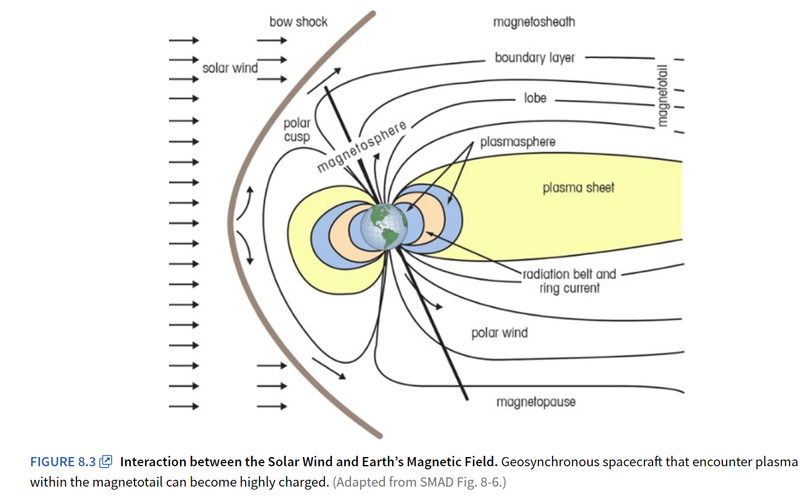
Earth’s Magnetosphere

Slide 26
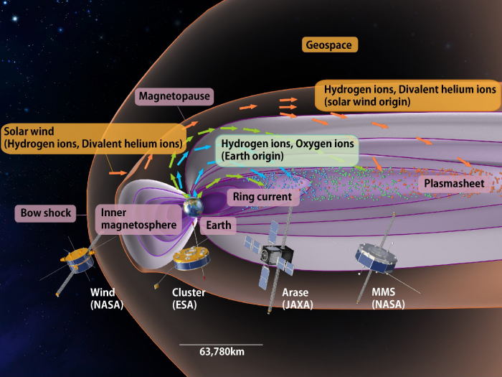
Observations of the solar wind and geospace by the combination of satellites from Japan, the USA and Europe. The results revealed that the plasma in the inner magnetosphere when a space storm develops is mainly composed of plasma originating from the Earth, rather than those from the solar wind. (© ERG science team)
Notes:
https://www.isas.jaxa.jp/en/topics/003566.html?utm_source=chatgpt.com

Slide 27
Radiation
Notes:
Radiation
What it is: Energy traveling in waves or particles, including light, X-rays, gamma rays, or particles like alpha/beta/neutrons.
Key Properties: Carries energy, can penetrate matter, and interacts with atoms.
How it relates to plasma: Radiation can be absorbed, emitted, or scattered by plasma, changing the plasma's state (ionization, temperature).
Plasma is a state of matter (ionized gas) that produces radiation (photons, X-rays, etc.) as charged particles emit energy, while radiation is electromagnetic energy (like light, X-rays) that can interact with and ionize plasma, causing chemical changes, making them deeply connected but distinct concepts in physics. Think of plasma as the "source" (like the sun's corona) and radiation as the "message" or "energy wave" it sends out, with radiation also affecting the plasma itself.

Slide 28
Radiation
Sources:
Galactic Cosmic Rays (GCRs) are high-energy particles from outside the solar system
Solar Particle Events (SPEs) when large amounts of particles are spewed from the Sun
Van Allen radiation belts
Effects on spacecraft:
Can cause Single Event Phenomenon (SEP), which can have three effects:
Bitflip/Single Event Upset (SEU) – changes one bit
Single Event Latch-up (SEL) – part hangs up, draws excessive current, will not operate until power cycled
Single-Event Burnout (SEB) – causes device to fail permanently
Total Ionizing Dose (TID): Long-term accumulation of trapped charge in dielectrics.
Can generate background noise and produce spurious signals in various sensors
Strategies to mitigate impacts:
Shielding sensitive electronics
Design and parts selection (use radiation-hardened parts)
Redundancy
EDAC (error detection and correction – more to come on this in the TT&C lesson)
Notes:
Radiation
Energy, not matter.
Includes electromagnetic radiation (UV, X-rays, gamma rays) and energetic particles (protons, electrons, heavy ions).
Does not require a medium and does not “flow” around objects.
Key idea: radiation passes through materials, depositing energy along its path.
Radiation-driven spacecraft effects
Total Ionizing Dose (TID)
Long-term accumulation of trapped charge in dielectrics.
Leads to threshold shifts, leakage currents, and eventual failure.
Displacement damage
Lattice defects in semiconductors and solar cells.
Degrades gain, efficiency, and lifetime.
Single Event Effects (SEEs)
SEU: bit flip
SEL: latchup (potentially destructive)
SEB/SEGR: power device failure
Radiation problems are often device-physics-dependent, not geometry-driven.
Radiation mitigation
Shielding (aluminum, tantalum, graded-Z)
Radiation-hardened electronics
Error detection and correction (EDAC)
Redundancy and watchdog architectures
Mission dose budgeting

Slide 29
Van Allen Radiation Belts
Regions of high-energy particles, mainly protons and electrons, held captive by Earth’s magnetic influence
Permanent hazard to orbit spacecraft, with particles distributed non-uniformly with Earth’s magnetosphere
South Atlantic Anomaly is a volume of space centered on South America’s east coast, where Earth’s inner Van Allen belt comes closest to the surface due to a weakness in Earth’s magnetic field
An increased flux of particles exists within this space and exposes spacecraft to higher than usual radiation levels

Slide 30
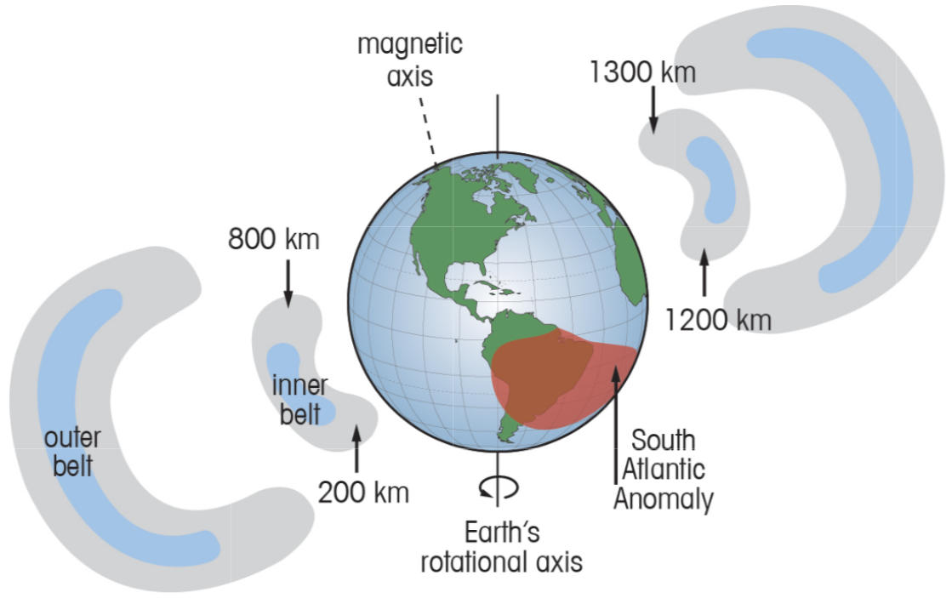
Van Allen Radiation Belts
Designing Space Missions and Systems, Fig 8.5

Slide 31
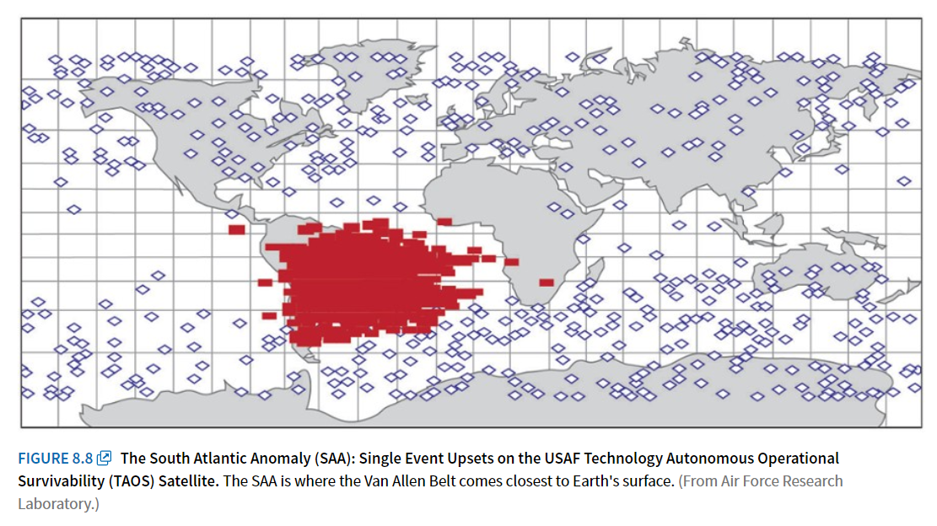
South Atlantic Anomaly

Slide 32
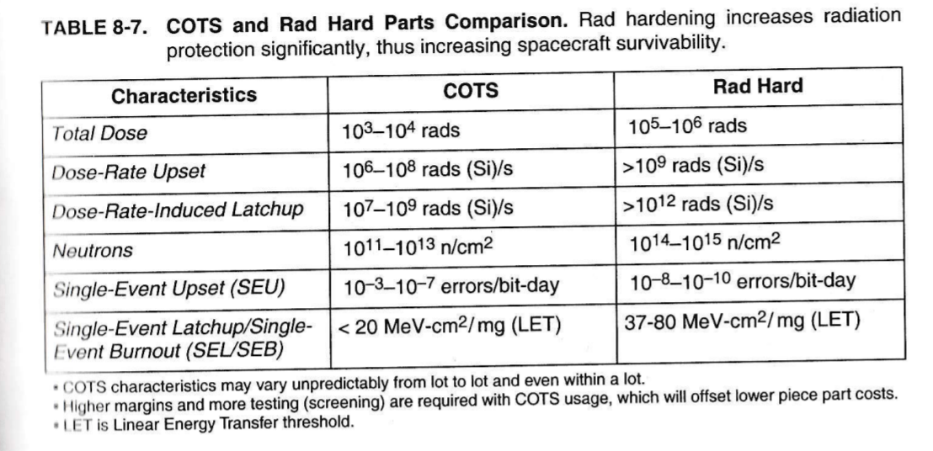
COTS vs Rad Hard Parts

Slide 33
Micrometeroids & Orbital Debris

Slide 34
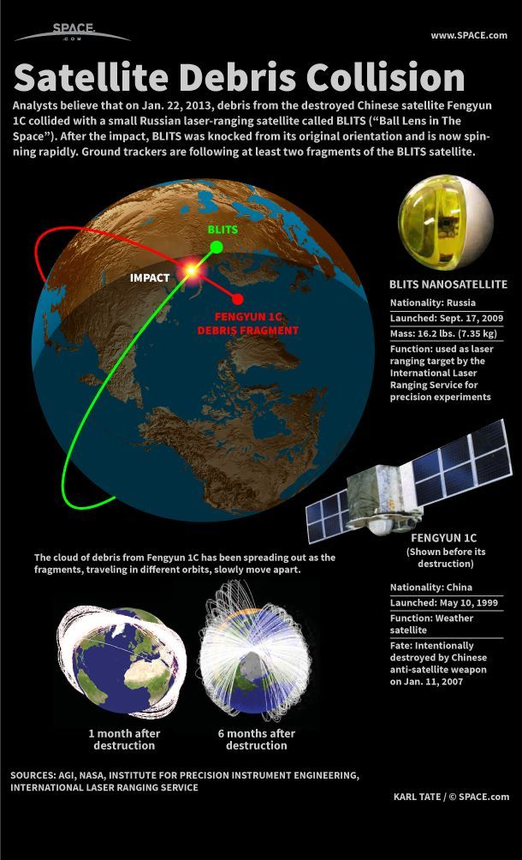
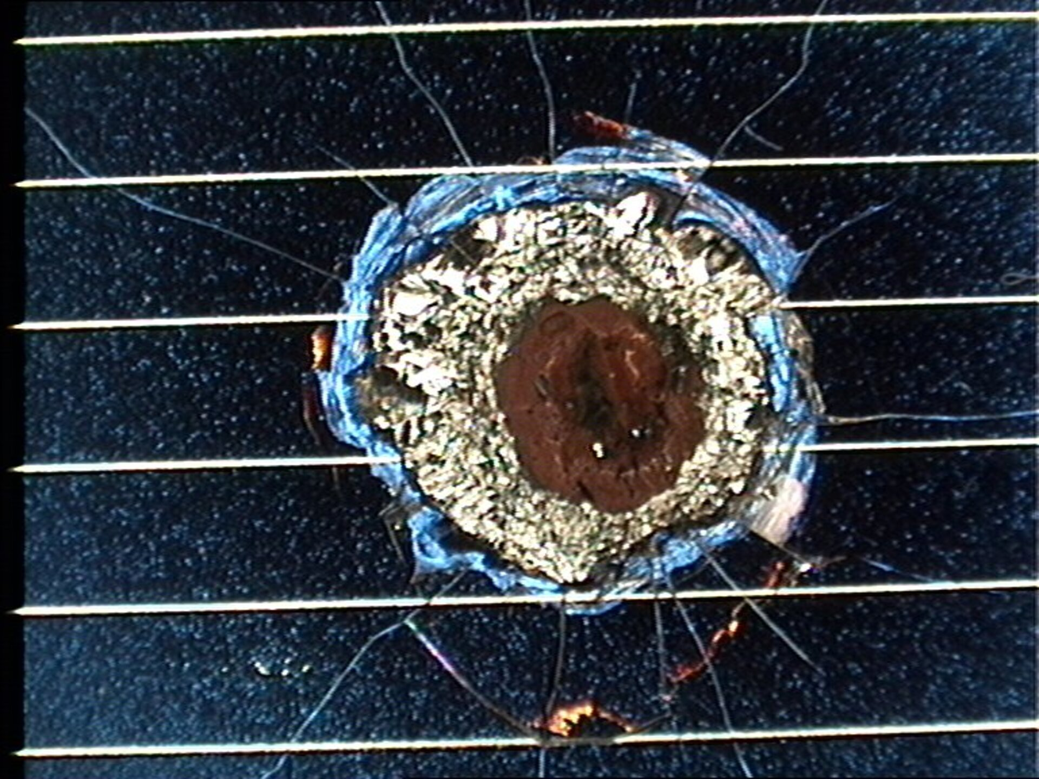
Micrometeoroids and Orbital Debris (MMOD)
Source:
Defunct spacecraft, rocket bodies and spacecraft debris are still in orbit and are not controlled
Effects on spacecraft:
Kinetic damage from collision
Strategies to mitigate impacts:
Choose orbits with minimal debris (if possible)
Have additional propellant on-board for collision avoidance maneuvers
Plan to dispose of spacecraft at end of mission life

Slide 35
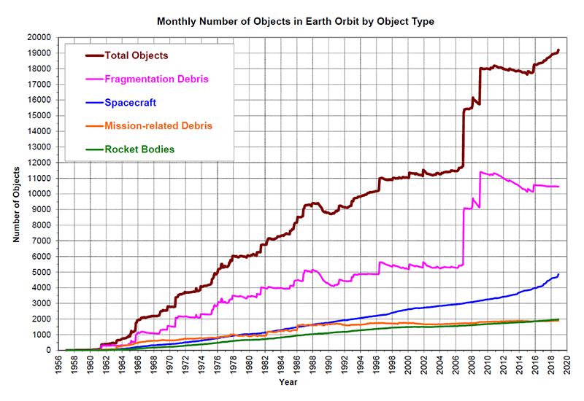
Orbital Debris
Source: NASA Orbital Debris Program Office

Slide 36
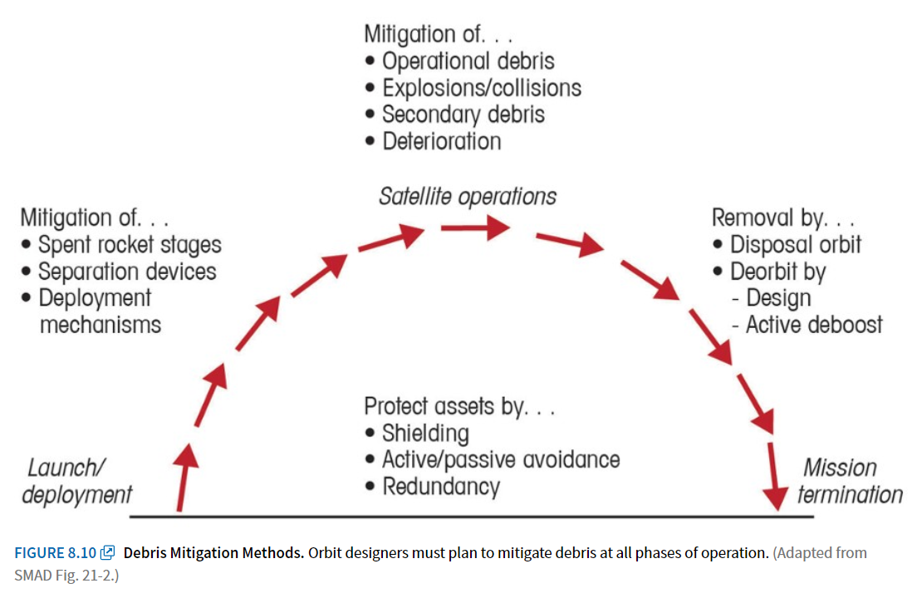
Debris Mitigation

Slide 37
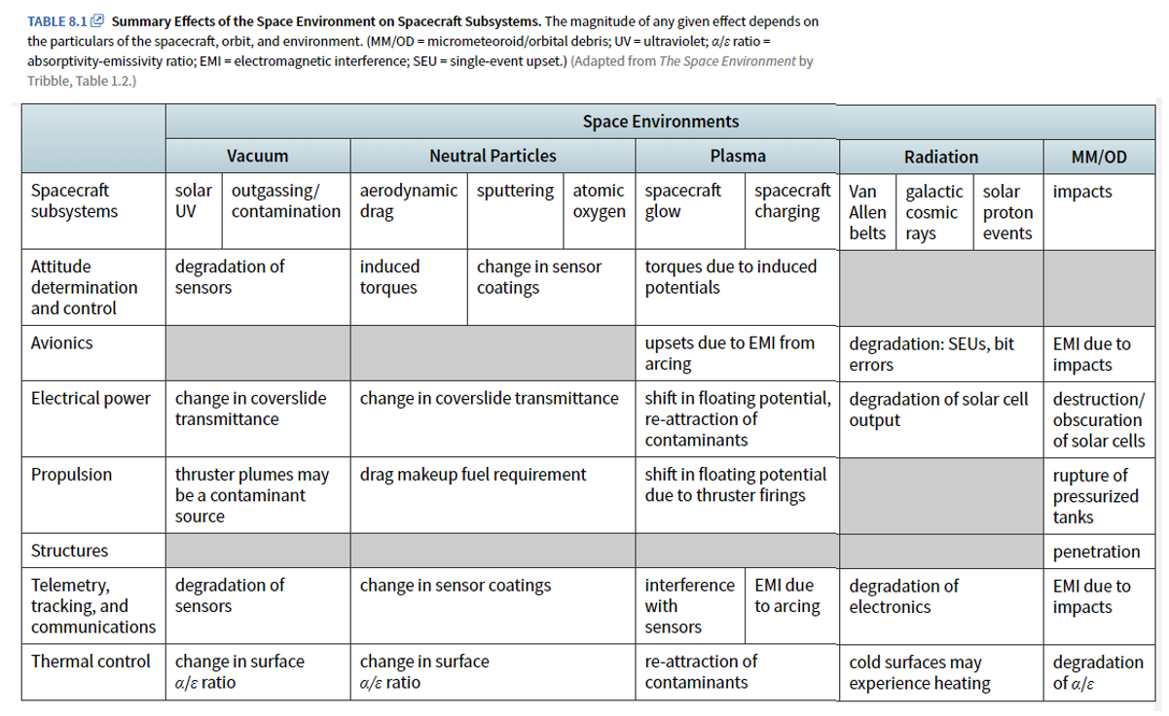
Space Environment (Key Takeaways)

